Slide 1
Presented by
Remote access to mobile phone

Slide 2
Introduction
Nowadays, usage of mobile has become a vital part of day-to-day activities of people
remote accessing of mobile becomes necessary when the mobile is left in some where like house or office.
An application that provides options to access a smartphone through other smartphone or a normal mobile via Short Message Service
This application provides option to track the information present in the smartphone.
It enables the remote user to control the mobile through SMS.

Slide 3

Server service
Client interface
Client service
response

Slide 4
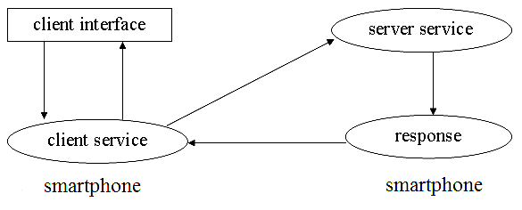

Slide 5
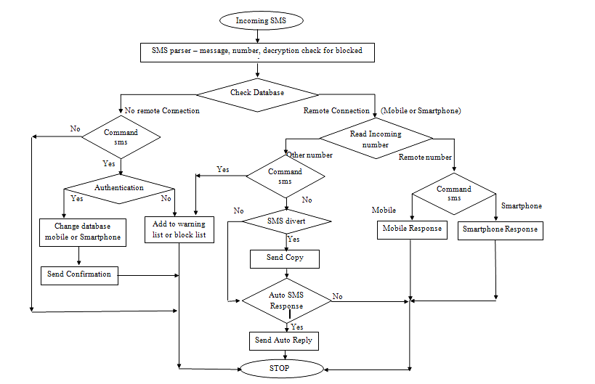

Slide 6
HARDWARE REQUIREMENTS:-
1) Cell phone as SMSC
2) Android Smart Phone.
3) A personal computer with atleast
2.0 Ghz Dual Core processor.
2 GB RAM.
20 GB HDD.

Slide 7
SOFTWARE REQUIREMENTS:-
JDK(Java Devlopment Kit) version greater than 1.5
Android Devlopment Tools (ADT)
Eclipse IDE.

Slide 8
Advantages
IT provides an opportunity to access your mobile phone remotely.
It also provides the location(latitude and longitude) of the mobile device in case of theft.

Slide 9
Disadvantages
Your mobile should be android and it must have this app installed.
Allows the app to send SMS messages. This may result in unexpected charges. Malicious apps may cost you money by sending messages without your confirmation.

Slide 10
Conclusion
The proposed model facilitates accessing of the device from a remote location using any other mobile terminal.
The system has been designed in such a way that the mobile terminal used for accessing the remote android device, need not be an android device.

